Slide 1
PPT on Cause of Death
Submitted by:
Suraj Kumar
Internship Batch: 34

Slide 2
Problem Statement:
We have a Dataset which contains Historical Data of different cause of deaths for all ages around the World.
We need to give findings and conclusions in detailed data analysis.

Slide 3
EDA Steps
Finding shape of data.
Information of data contain.
Data types
Statistical Summary
Correlation between data
Analysis of data after plotting them into graphs

Slide 4
Statistical Summary Analysis
Observations:
Average about 12550 people died every year due to Neonatal Disorders.
Highest number of deaths due to Neonatal Disorders in a year is 852761
There are certain more disease due to which highest number of people dies every year they are like, Tuberculosis, Lower Respiratory Infections, HIV/AIDS, Digestive Disease etc.
Highest number of people died due to conflict and Terrorist in a year Is 503532 this is very huge. May be these people don’t have an disease.
Average 5930 people dies every year in Road Injuries.
Poison is the less factor of people death per year.

Slide 5
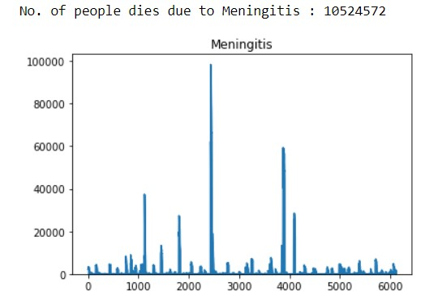
Total deaths due to Meningitis:

Slide 6
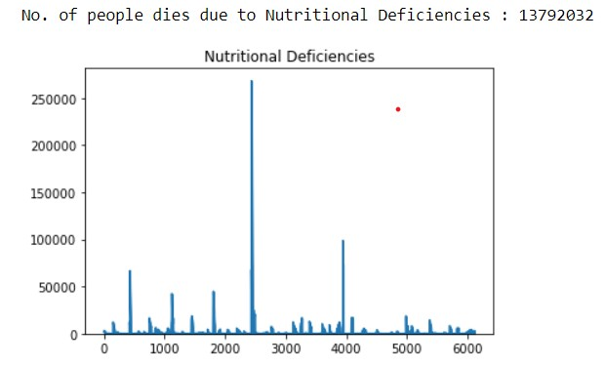
Death due to Nutritional Deficiencies

Slide 7
Observations of Univariate Analysis:
Highest number of people dies due to Cardiovascular Disease.
Forces of Nature played least role to people death.
Digestive, Chronic Respiratory, Neoplasms, Diarrheal, Neonatal, Lower Respiratory Infections, these disease are the reason due to which most number of people died.
Parkinson, Maternal Disorders, Drug use Disorders, Alcohol use Disorders, Conflict and Terrorism, Poisonings, Fire Heat and Hot Substances, Acute Hepatitis are the least factors of death of people.

Slide 8
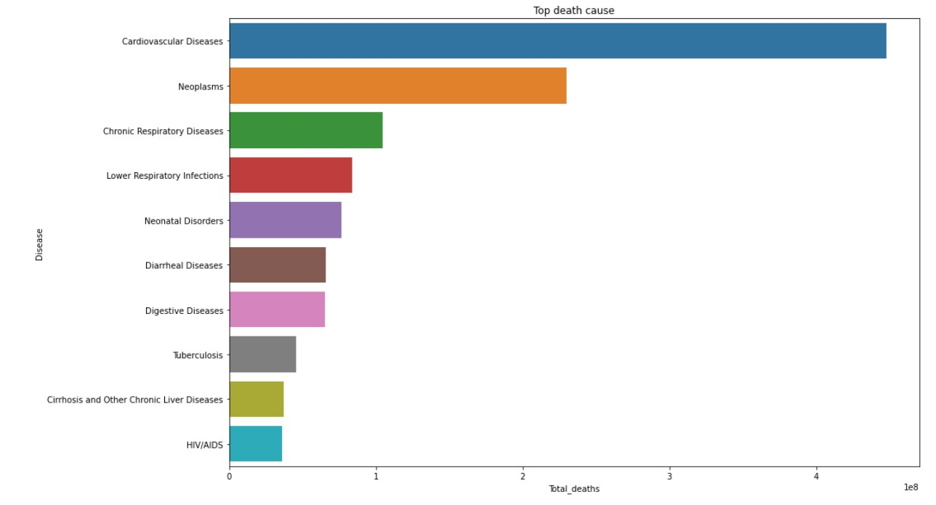
Top Death Causes

Slide 9
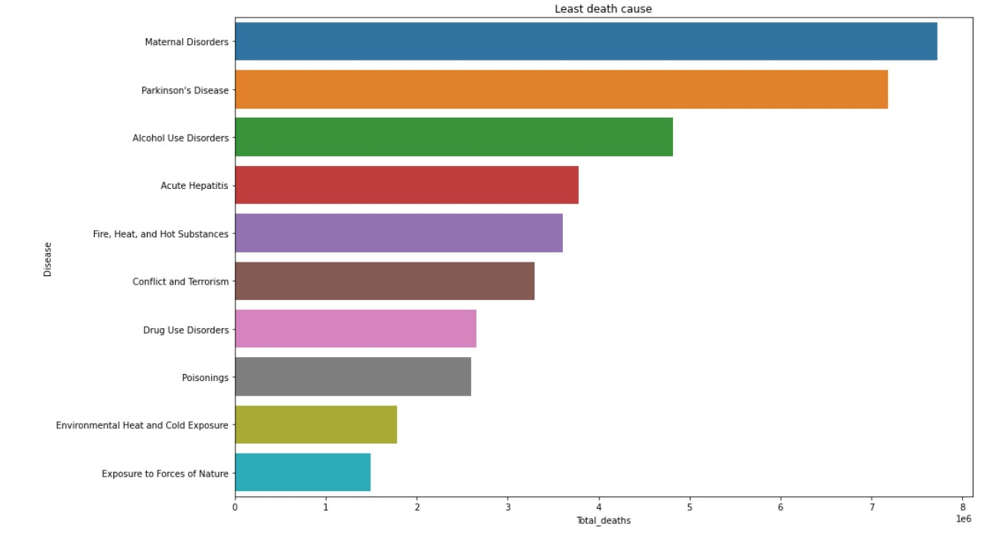
Least Death Factors

Slide 10
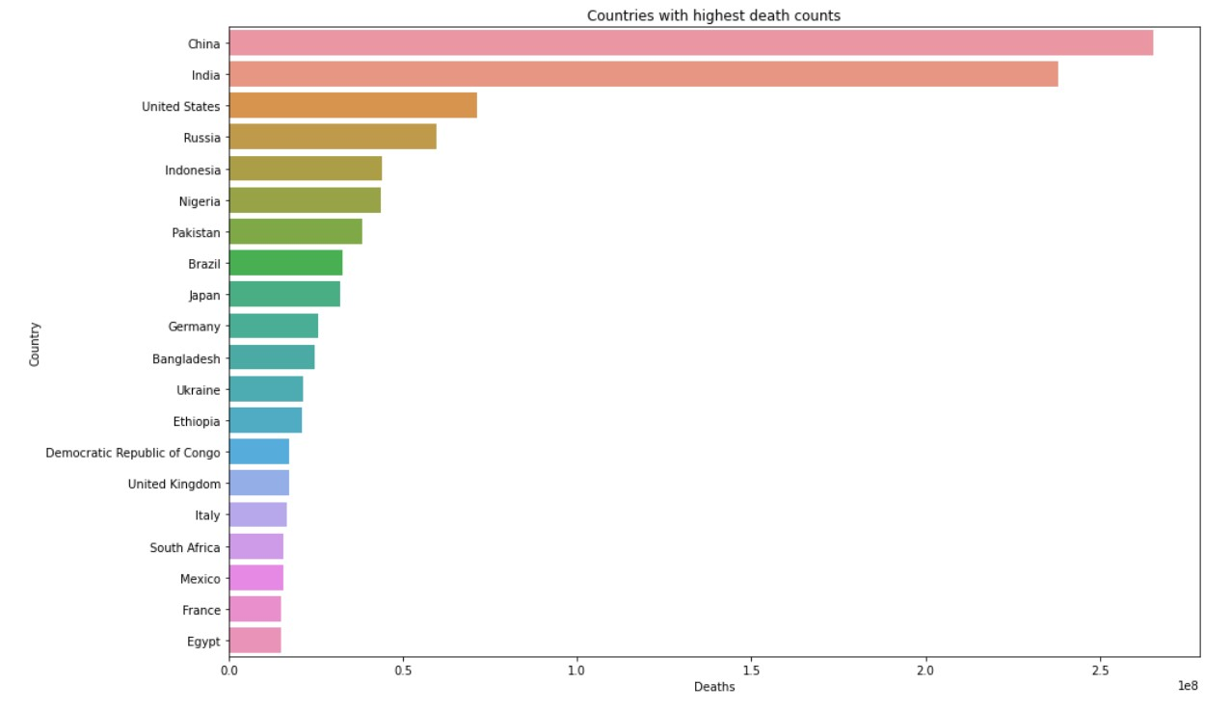
Countries with highest death count

Slide 11
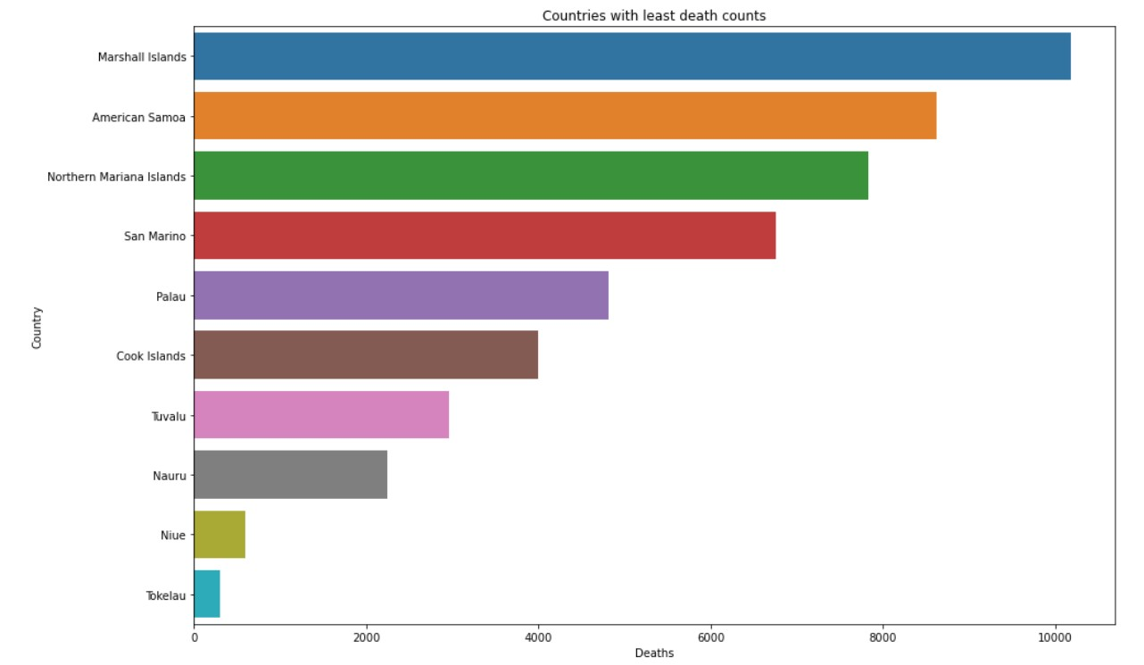
Countries with least death count

Slide 12
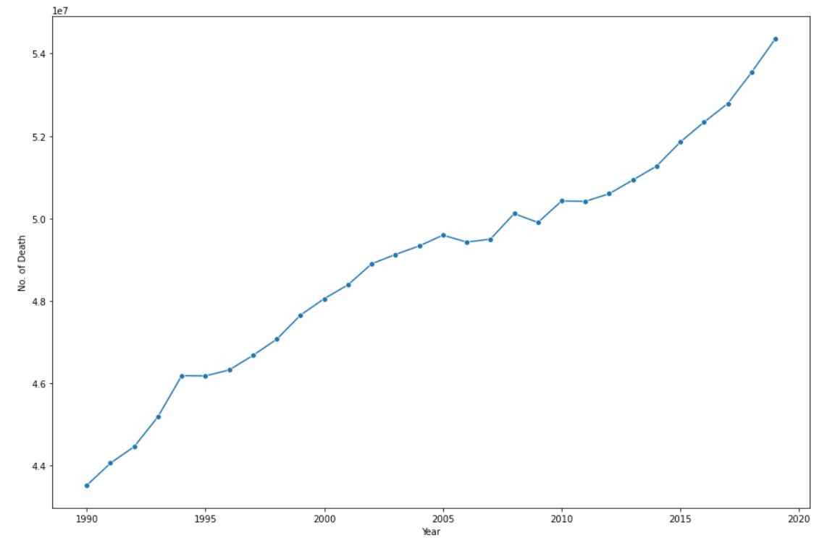
Death numbers every year

Slide 13
Conclusion
After analysis and visualisation, we have found following things from the data:
There is certain disease which are highly correlated to each other it means that if a person has one disease, then it is quite possible that he can suffer from other disease also.
There are certain countries in which cause of death are high due to same type of disease.
Most number of deaths occurs due to certain 10 to 15 types of disease these are more than half of total death.
Every year showing similar behaviour in case of death due to certain disease i.e., every year the greatest number of people dies due to certain same type of disease.
There is certain disease due to which there is no any death occurs in some countries.
Some countries have highest death numbers.

Slide 14
Thanks

